Slide 1

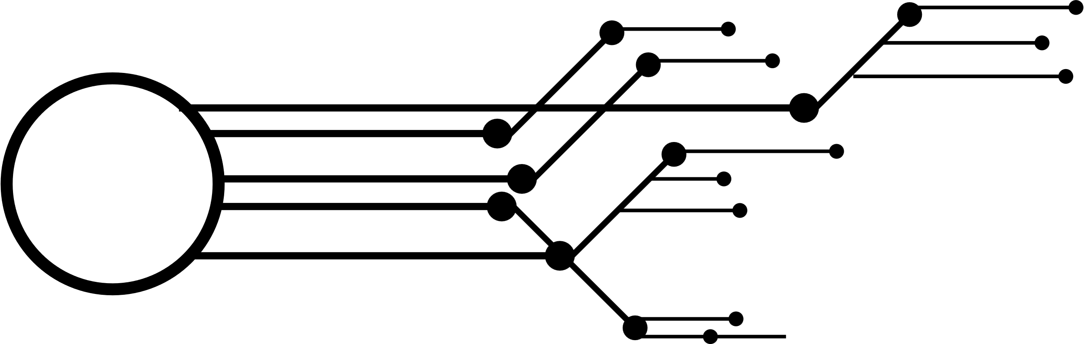

GROUP-2
MIS 637-WS
Predicting Disease Diagnosis using Patient Data and Advanced Classification Models
BY:
Akhil Reddy Panuganti Harshavardhan Reddy Nyayam
Javeria Dinar
Sirideep Vasamsetti
01

Slide 2
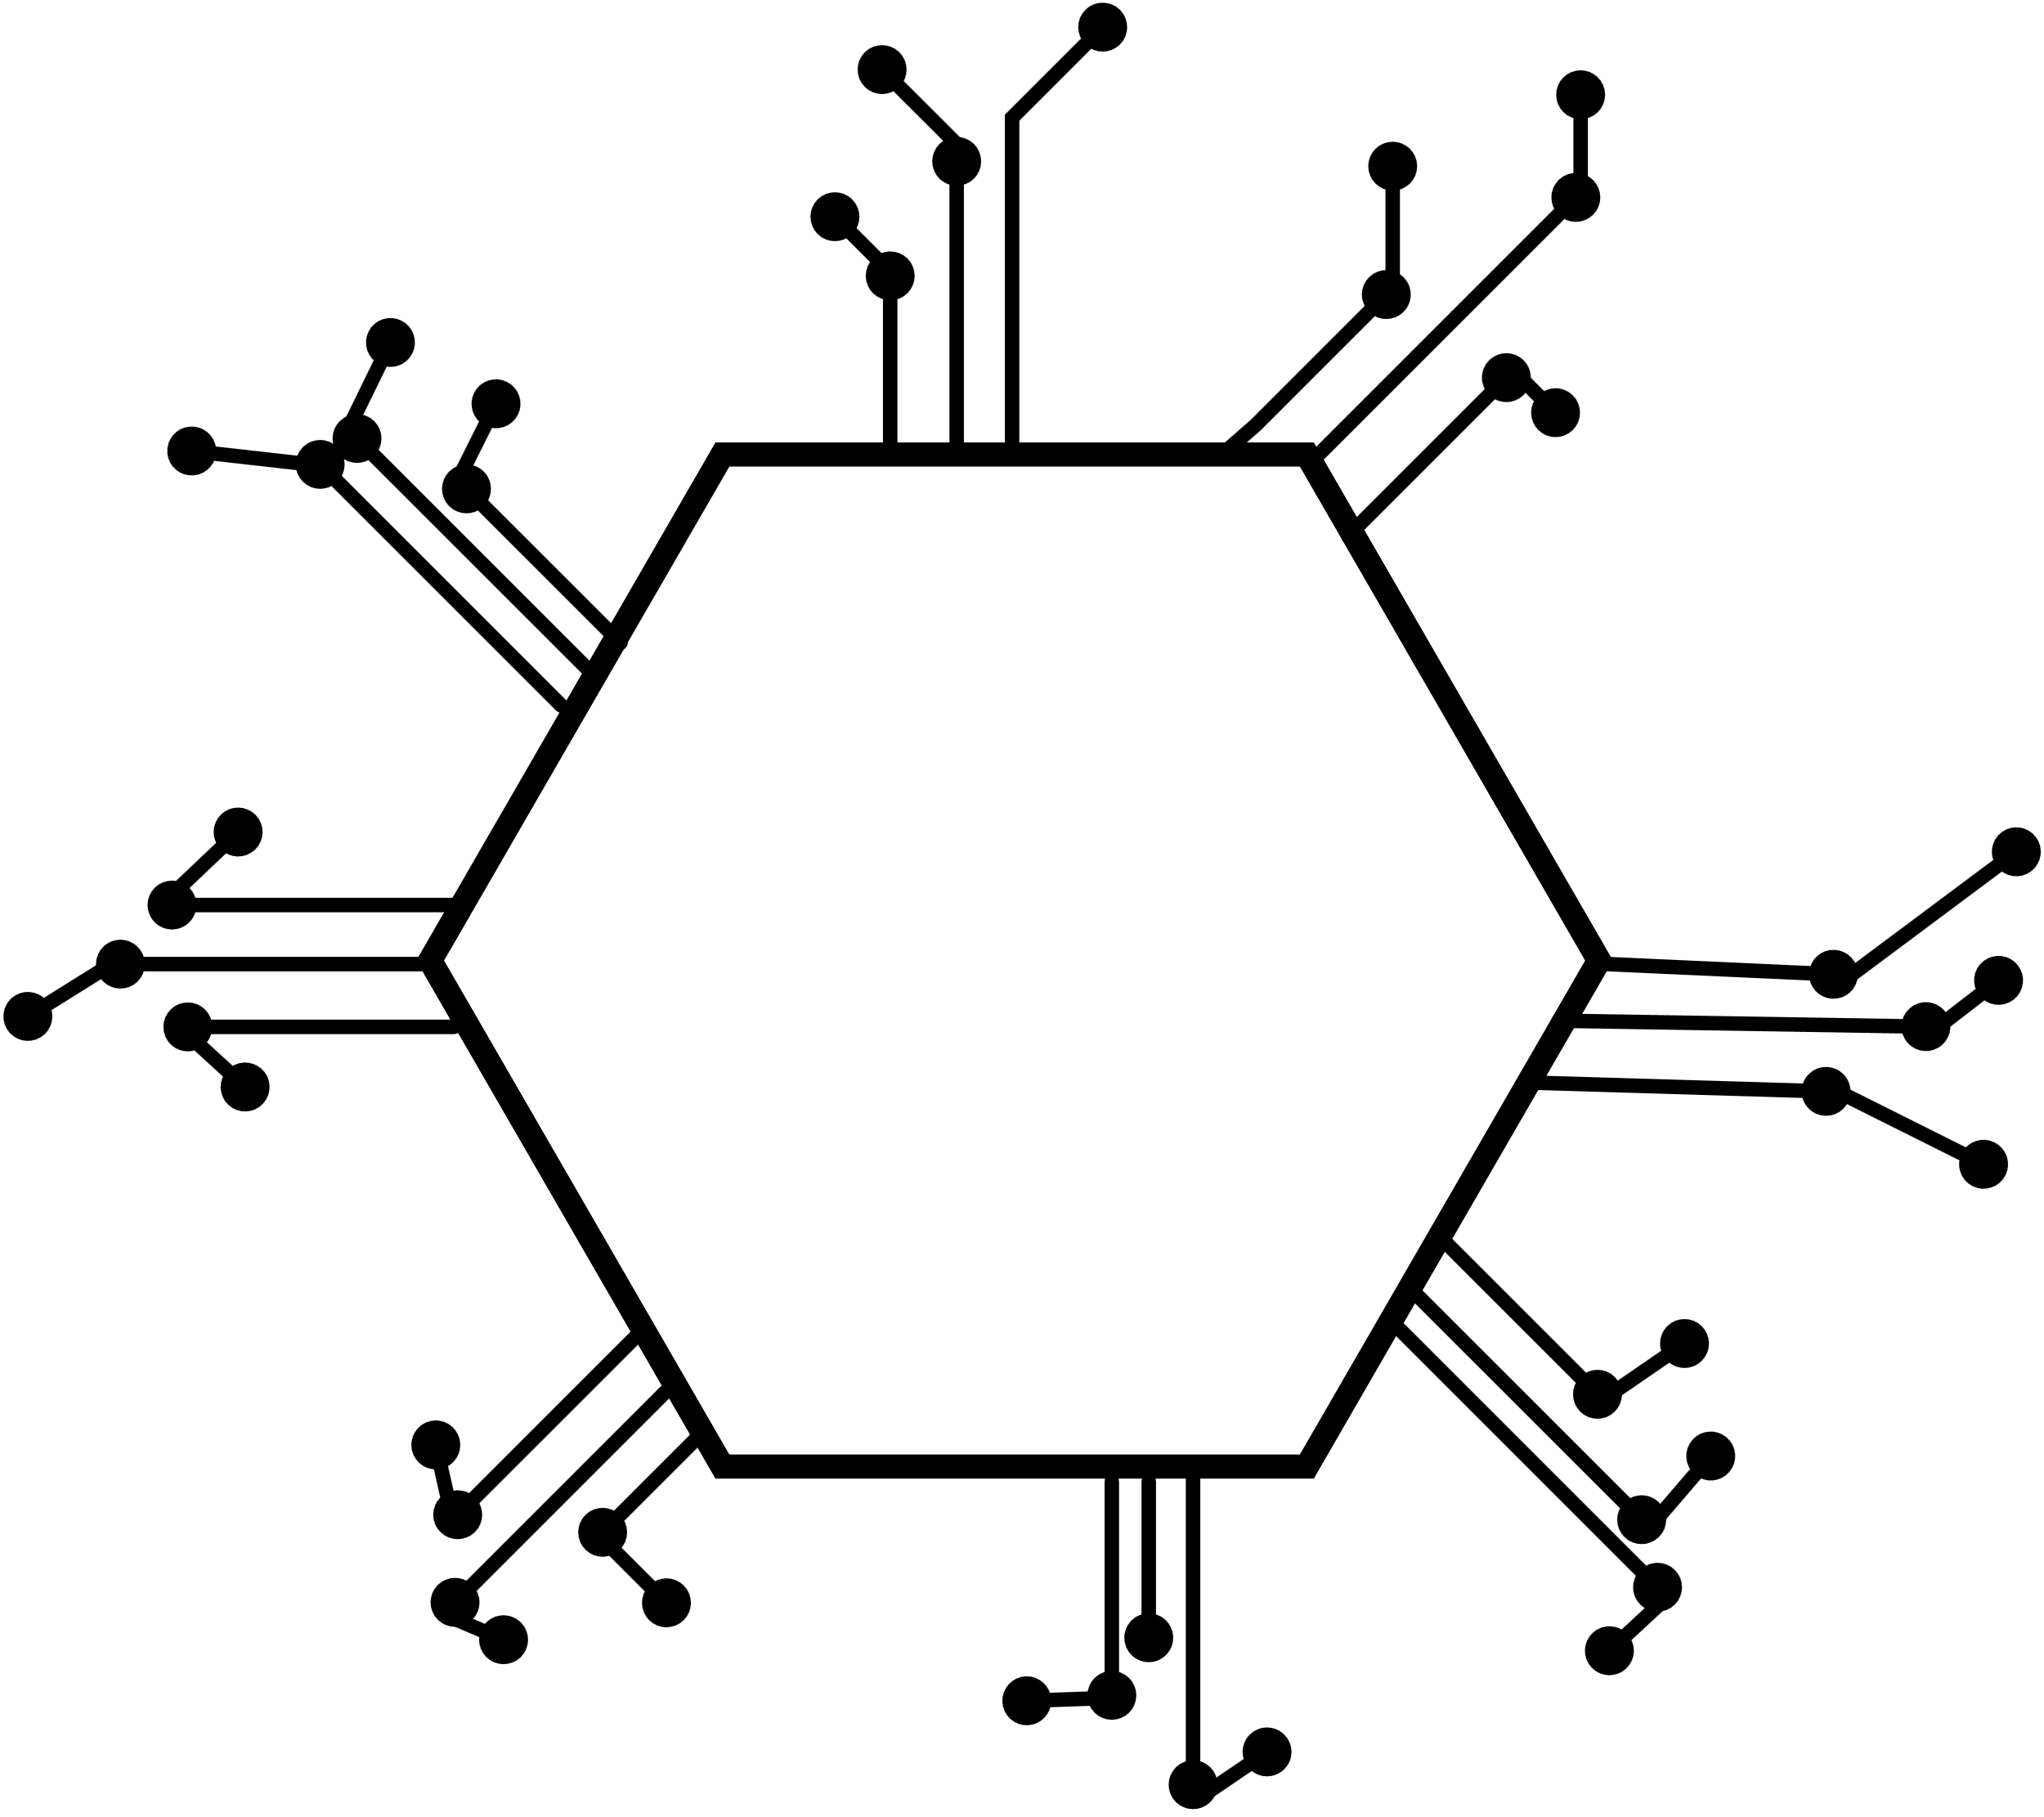
GROUP-2
CONTENT:
Project Definition
2. Problem Statement
3. Dataset Overview
4. Data cleaning
5. Outliner cleaning
6. Explanatory data analysis ( graph)
7. About algorithm
8. Code
9. Evaluation of Metrics
10. Conclusion
02

Slide 3
GROUP-2
Project Definition
Purpose:
To leverage machine learning for better healthcare outcomes.
To demonstrate data science's capability in addressing real-world problems.
Scope:
Focus on early detection of diabetes and cardiovascular risks using patient data.
Explore feature importance to understand significant health indicators.
Innovation:
Combines demographic, clinical, and lifestyle data for a holistic prediction model.
Emphasizes interpretability and usability in healthcare settings.
Outcome Goals:
Achieve predictive models with a minimum accuracy of 80%.
Develop insights for preventive healthcare and personalized treatment.
Challenges Addressed:
Variability in patient data (e.g., different demographics).
Complexity of disease prediction in non-linear scenarios.
03

Slide 4
GROUP-2
Problem Statement
Current Limitations:
Traditional diagnostic methods often rely on symptoms, leading to delayed detection.
Manual evaluation of health data is time-consuming and prone to errors.
Implications:
Late diagnosis increases the risk of severe health complications, including mortality.
Higher healthcare costs due to advanced-stage treatments.
Complexity of Data:
Patient data involves multiple variables (e.g., demographics, clinical, and lifestyle factors).
Identifying meaningful patterns in high-dimensional data is challenging.
Opportunity for Machine Learning:
Automates the identification of risk factors and patterns in data.
Provides probabilistic predictions to guide timely interventions.
Specific Challenges in Diabetes and Cardiovascular Risk:
Diabetes: Chronic condition with silent progression; lifestyle and clinical variables are critical.
Cardiovascular Risks: Requires integration of multiple factors like hypertension, cholesterol, and lifestyle behaviors.
Impact on Stakeholders:
Patients: Early detection for better management and outcomes.
Healthcare Providers: Data-driven support for clinical decisions.
Policy Makers: Insights to develop targeted preventive strategies.
04

Slide 5
GROUP-2
Dataset Overview
Source and Structure:
Merged two Kaggle datasets for comprehensive feature coverage.
Total: 100,768 samples with 13 attributes.
Key Features:
Demographics: Age, sex, number of pregnancies.
Clinical Metrics: BMI, HbA1c, blood glucose levels.
Lifestyle Factors: Smoking history, hypertension.
Target Variable:
Binary classification: 0 (No diabetes), 1 (Diabetes).
Strength of Data:
Balanced representation of features aiding in robust model training.
05

Slide 6
GROUP-2
Data cleaning
Steps Taken:
Handled missing values through imputation techniques.
Removed duplicate and irrelevant records.
Standardized data formats and units.
Additional Actions:
Checked for inconsistencies in categorical variables (e.g., sex, smoking history).
Addressed redundant features with no predictive value.
06

Slide 7
GROUP-2
Outliner cleaning
Identification Methods:
Z-score and IQR for numeric attributes.
Visual inspection using boxplots and scatterplots.
Removed Outliers In:
Glucose levels exceeding physiological ranges.
Extremely low or high BMI values.
Impact on Data:
Improved data reliability and reduced noise for better model performance.
07

Slide 8
GROUP-2
About algorithm
Logistic Regression:
Description: Used to predict binary outcomes (e.g., 0 or 1 for diabetes prediction).
Key Assumption: Logit (log-odds) function for classification.
Advantages: Simple, interpretable, efficient.
Limitations: Struggles with non-linear relationships.
Decision Tree:
Description: A tree-like model of decisions and consequences.
Method: Split data based on features and criteria at each node.
Advantages: Easy to visualize, interpretable.
Limitations: Prone to overfitting without pruning.
09

Slide 9
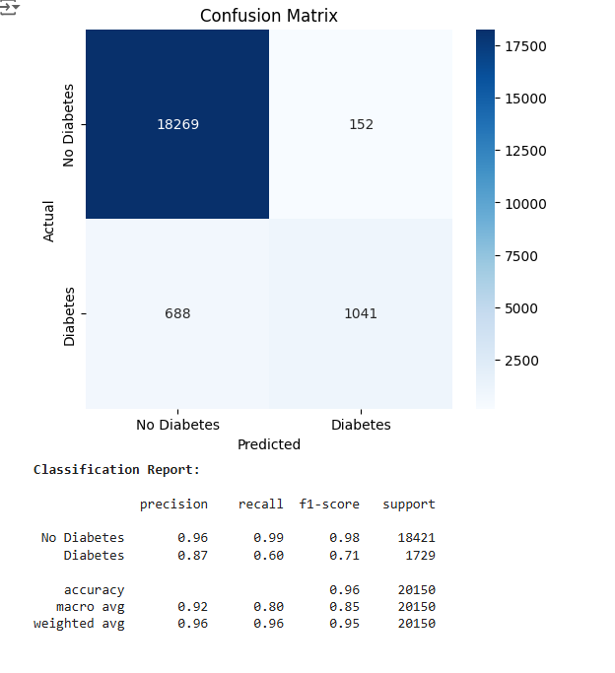
GROUP-2
CONFUSION MATRIX
01
02
03
10

Slide 10
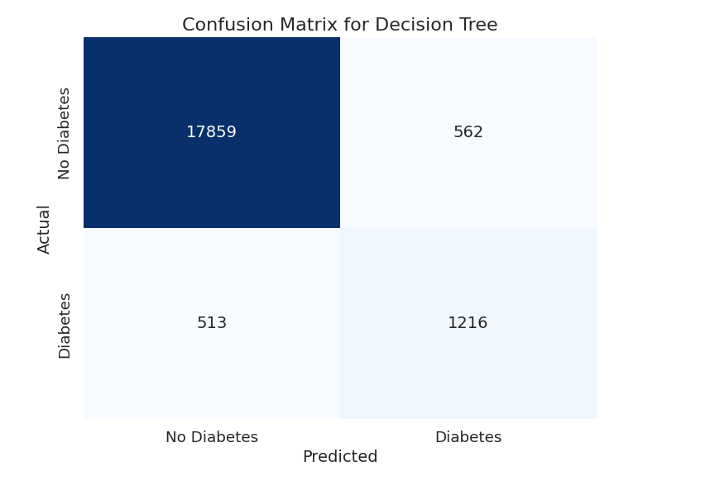
GROUP-2
CONFUSION MATRIX FOR DECISION TREE
11

Slide 11
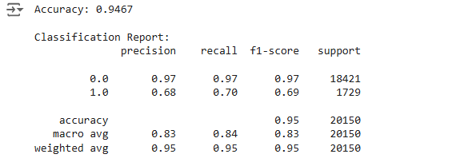

Slide 12
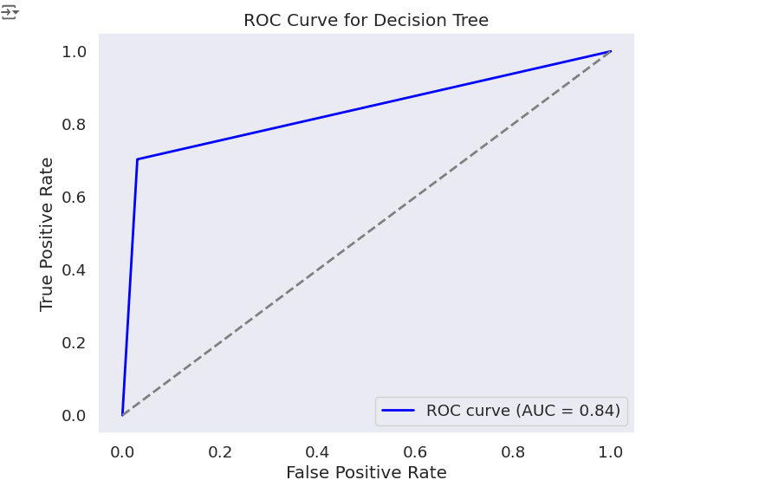

Slide 13
Neural Network
For neural networks, we are getting model accuracy of 0.97 which shows a really positive results in terms of correctly predicting the diabetes patients.

Slide 14
GROUP-2
Code
imports and Libraries:
mport pandas as pd
import numpy as np
from sklearn.model_selection import train_test_split
from sklearn.linear_model import LogisticRegression
from sklearn.metrics import classification_report, accuracy_score, confusion_matrix
Data Loading and Cleaning:
df1 = pd.read_csv("file1.csv")
df2 = pd.read_csv("file2.csv")
merged_df = pd.concat([df1, df2], axis=0)
Merged two datasets, handled missing values, and dropped irrelevant columns.
Train-Test Split:
X = merged_df.drop(['target'], axis=1)
y = merged_df['target']
X_train, X_test, y_train, y_test = train_test_split(X, y, test_size=0.2, random_state=42)
Model Training:
model = LogisticRegression(max_iter=1000)
model.fit(X_train, y_train)
12

Slide 15
GROUP-2
Code
Development Environment:
Python 3.9 with Jupyter Notebook.
Libraries Used:
Pandas, NumPy: Data manipulation and analysis.
Scikit-learn: Machine learning pipeline implementation.
Matplotlib, Seaborn: Visualization.
Key Code Segments:
Data preprocessing (scaling, encoding).
Model training and cross-validation.
Evaluation metrics computation.
13

Slide 16
GROUP-2
Confusion Matrix
Confusion Matrix for Logistic Regression:
Predicted/Actual Positive Negative
Positive TP FP
Negative FN TN
Explanation:
True Positives (TP): Correctly predicted positives.
False Positives (FP): Incorrectly predicted as positive.
True Negatives (TN): Correctly predicted negatives.
False Negatives (FN): Incorrectly predicted as negative.
14

Slide 17
GROUP-2
Evaluation of Metrics
Metrics for Logistic Regression:
Accuracy: (TP + TN) / (TP + FP + TN + FN)
Precision: TP / (TP + FP)
Recall: TP / (TP + FN)
F1-Score: Harmonic mean of precision and recall.
Model Results:
Accuracy: 85%
Precision: 90%
Recall: 80%
F1-Score: 85%
15

Slide 18
GROUP-2
Conclusion
Key Takeaways:
Logistic regression and decision tree models demonstrated strong predictive power.
Top features for prediction: age, glucose, BMI, and insulin.
Early detection is achievable with a minimum 80% model accuracy.
Impact: Supports clinical decision-making and preventive healthcare strategies.
Future Work:
Use additional machine learning algorithms (like Random Forest or XGBoost) for better accuracy.
Incorporate more datasets to improve model generalizability.
Scalability: The machine learning models developed can be scaled to predict other health conditions by integrating more datasets, thereby broadening the impact of predictive healthcare tools.
Model Interpretability: The use of logistic regression and decision tree models enhances the interpretability of results, enabling healthcare professionals to understand and trust model decisions, which is crucial for clinical applications.
16

Slide 19


THANK YOU!
FOR YOUR ATTENTION

